Slide 1

The Science of Turning Data to Actionable Knowledge
Cheng Peng

Slide 2
Agenda
What Is Data Science?
The Life-cycle of A Data Science Project
Data Acquisition & Management
Model Building Loop
Model Deployment & Adjustment
Tools and Skills for Data Scientists

Slide 3
The First Rule of Data Science:
Don’t Ask How to Define Data Science!
Josh Bloom at the Berkeley Institute for Data Science (BIDS).

Slide 4
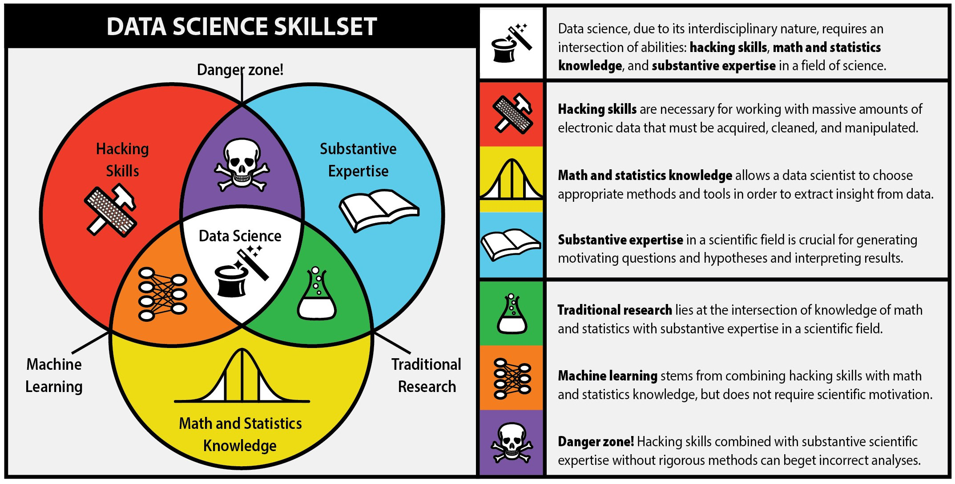
So What is Data Science?
[ Design: Natalia Bilenko, modified from Drew Conway ]

Slide 5
So What is Data Science?
from National Consortium
for Data Science (NCDS)
Data Science: Systematic study of organization and use of digital data for
research discoveries,
decision-making, and
the data-driven economy.
http://datascienceconsortium.org/

Slide 6
What is Data?
Data is a set of values of qualitative or quantitative variables; restated, pieces of data are individual pieces of information. Data is measured, collected and reported, and analyzed, whereupon it can be visualized using graphs or images. Data as a general concept refers to the fact that some existing information or knowledge is represented or coded in some form suitable for better usage or processing. [Wikipedia]
Data is recorded information.

Slide 7
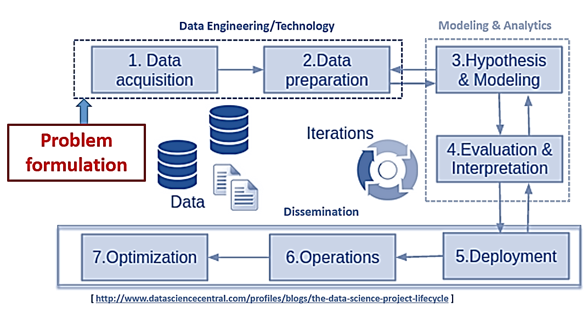
DS Project Lifecycle

Slide 8
Data acquisition is a set of processes and programs that extracts data for the data warehouse and operational data store from the operational systems
Data acquisition:
Basic Types of Data 1) Structured Data
2) Unstructured Data
3) Semi-structured Data

Slide 9
Data acquisition (Cont)
Machine Generated Data: images, videos, audios, radar and sonar data, …
Unstructured Data does not have a stable well-defined structure. It is either machine or human generated.
Human Generated Data: text within documents, social media data, website pages and log files, ……

Slide 10
Some Fancy Terms in Data Science
Big Data’s xV Definitions: (Volume, Velocity, Variety, Veracity, Value, Variability, Visualization, ….)
Data warehouse, data lake, data mart, ….
Data analysis vs data analytics: descriptive analytics, predictive analytics, prescriptive analytics, ……
Data management, cleansing, wrangling, munging, ….

Slide 11

Big Data, New Challenges!
Challenge #1: Data Storage – New Infrastructures
Challenge #2: Data Processing – New Tools and Methods for Information Extraction
Challenge #3: Analytical Modeling – New Methods with a Sound Theoretical Foundation
Challenge #4: Lack of Data Science Talent!

Slide 12
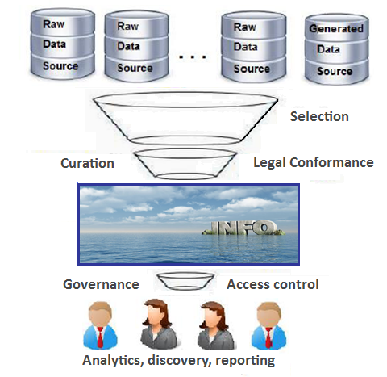
Data Lake
Data Wrangling: The Challenging Journey from the Wild to the Lake.
Source: Ignacio Terrizzano, Peter Schwarz, Mary Roth, John E. Colino from IBM Research

Slide 13

LET’S DIVE IN
Data Acquisition & Management
http://ebooks-store.com/dealing-big-data-ascendency-data-lakes/

Slide 14
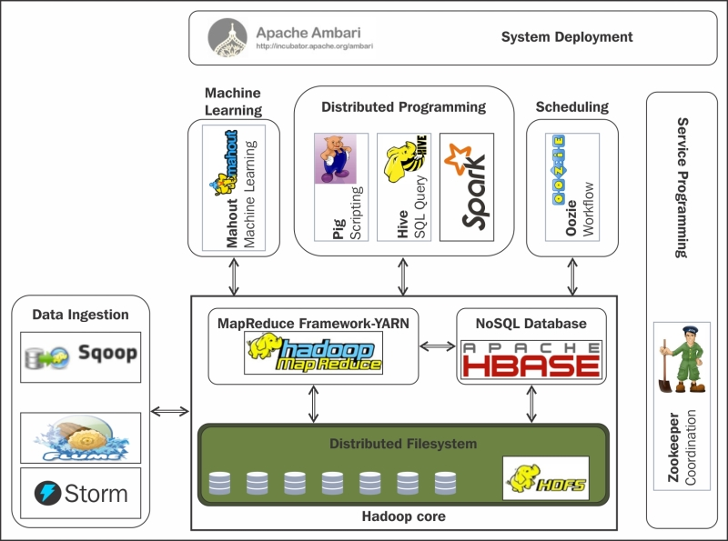
Data Technologies –
An At-a-glance View
Technologies for
Data Engineering
https://www.safaribooksonline.com/library/view/hadoop-essentials/9781784396688/ch02s05.html

Slide 15
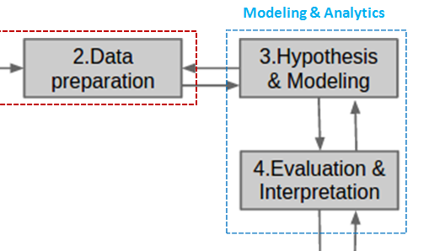
Modeling Building Loop:
A Recursive Process

Slide 16
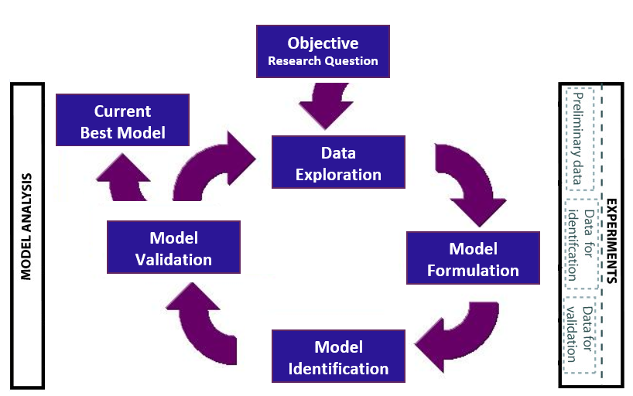
Modeling Building Loop:
A Recursive Modeling Process

Slide 17
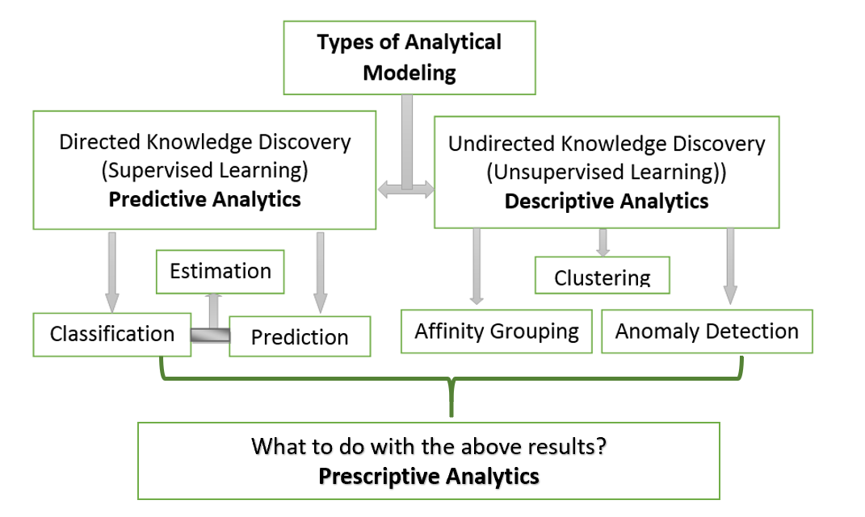
Model Building Loop:
Basic Types of Data
Science Modeling Problems

Slide 18
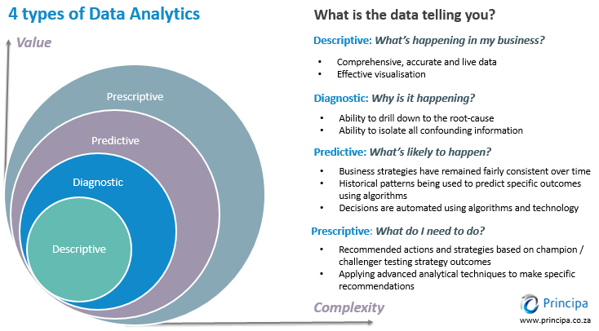
Model Building Loop
Description of
Science Modeling Problems

Slide 19
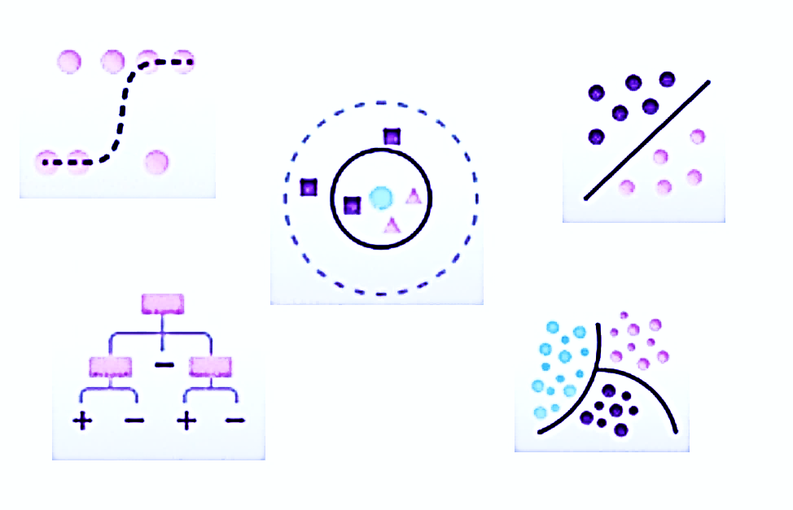
Model Building Loop:
Classification Models
(partial list)

Slide 20
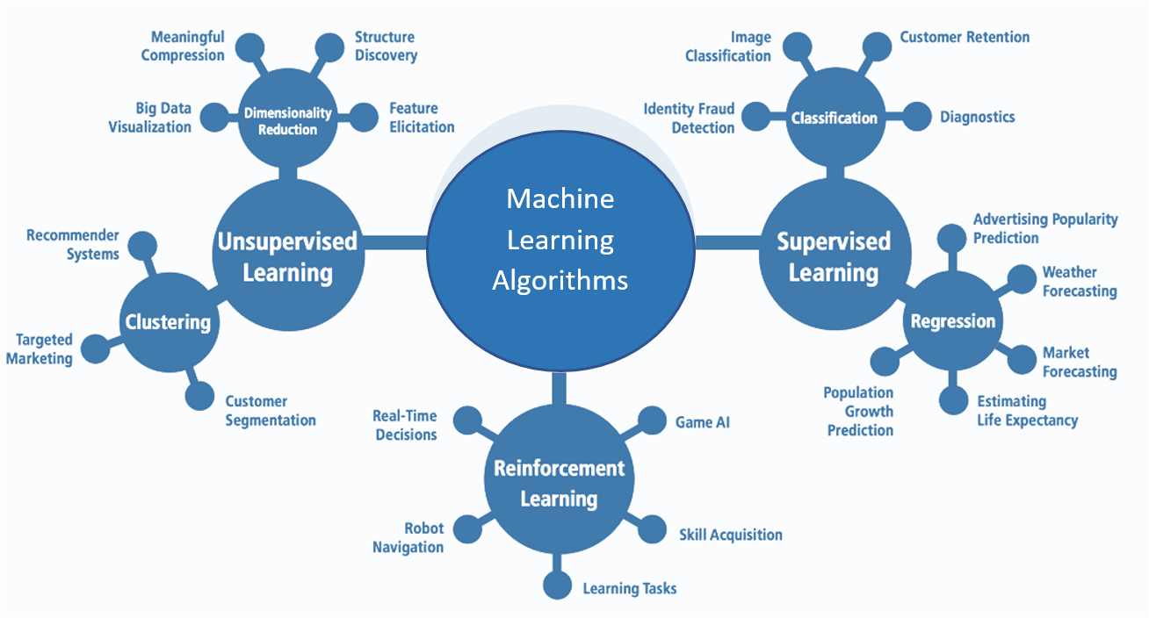
Model Building Loop:
Machine Learning Algorithms

Slide 21
Model Building Loop:
Approaches to
Data Science Models
Machine
Learning
Statistical
Learning
Data
Mining
Statistical
Modeling
Data Science Modeling

Slide 22
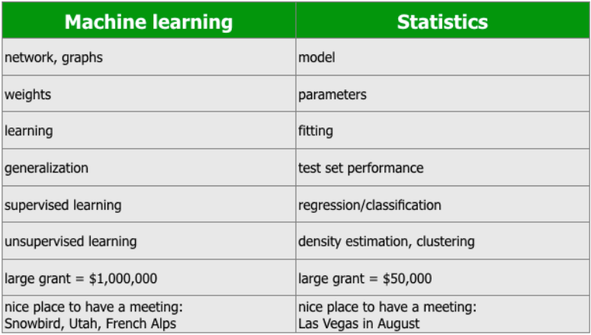
Model Building Loop:
Some Comparisons
Between ML & Stats
[ From a note of Robert Tibshirani ]

Slide 23
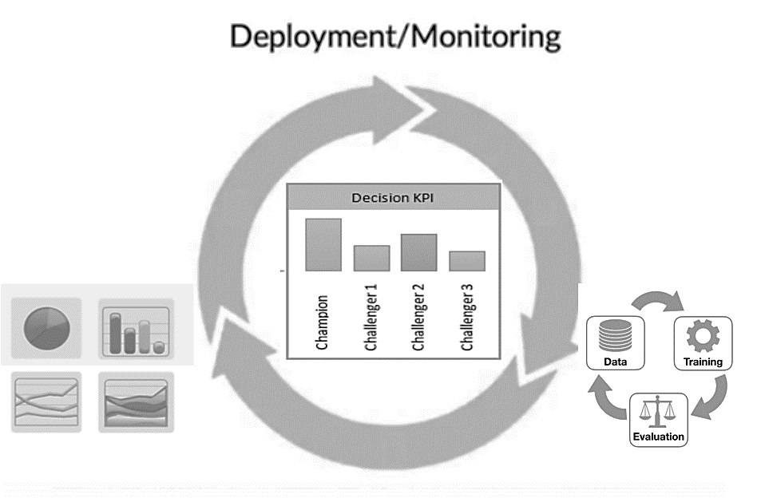
Deployment & Monitoring: Iterative Process

Slide 24
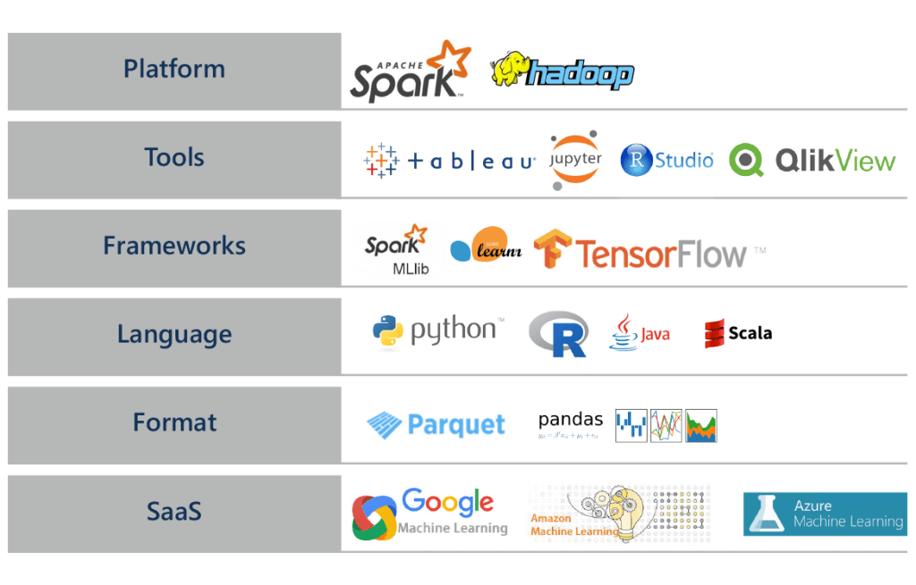
Data Science Tools and Technology

Slide 25
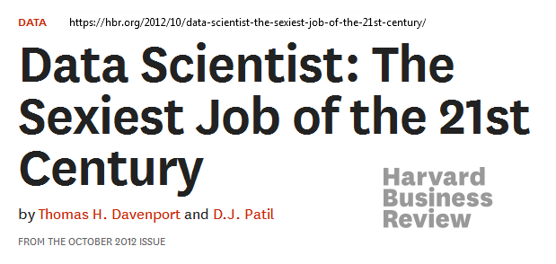
Tools and Skills for Data Scientists
What is a data scientist?

Slide 26
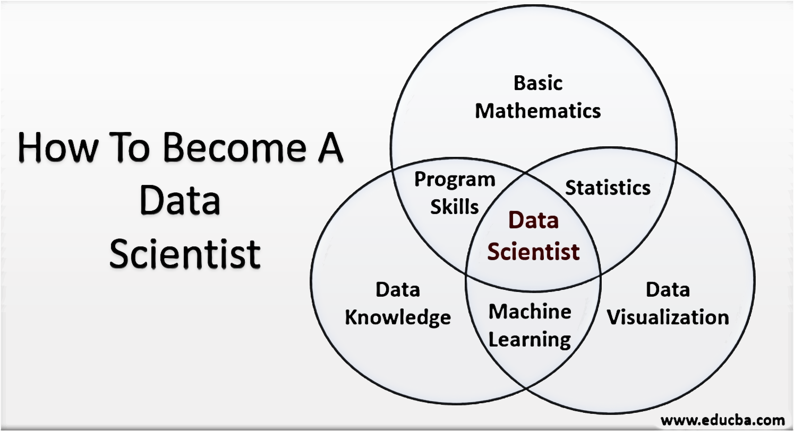
What is a data scientist?

Slide 27
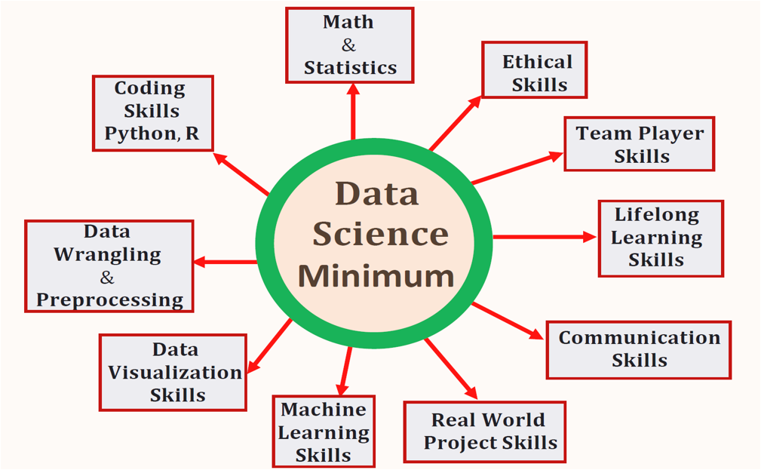
Tools and Skills for Data Scientists
Source: https://towardsdatascience.com/

Slide 28
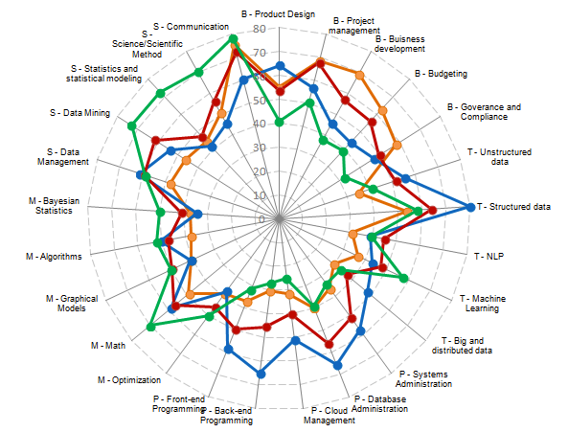
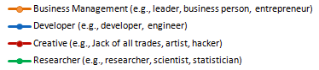

Tools and Skills for Data Scientists
DS Skills by Job Role
DS Skill Category
B – Business
T – Technology
P – Programming
M – Mathematics & Modeling
S – Statistics
DS Role /Types of Data Scientists
http://businessoverbroadway.com/wp-content/uploads/2015/09/datascienceblogroleskills.png

Slide 29
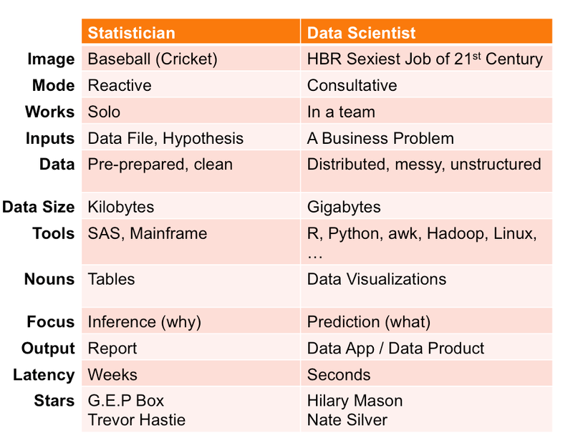
Analytical Tasks for Statisticians and Data Scientists

Slide 30
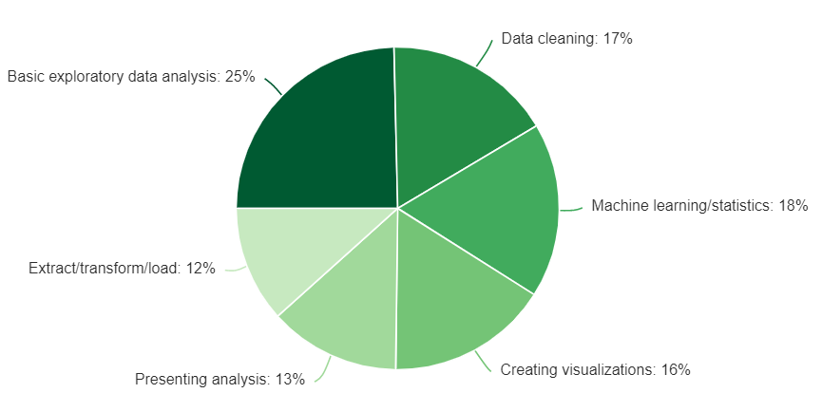
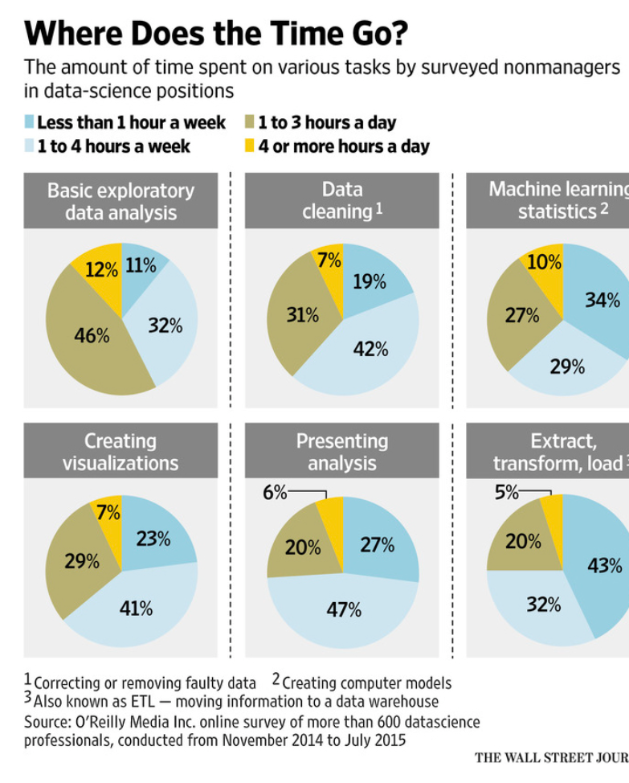
What does a data scientist do in a typical workday?

